Slide 1

Tourism Demand & Forecasting Dashboard

Slide 2

Introduction
Tourism Demand & Forecasting Dashboard
This project culminates in a comprehensive data analytics and forecasting dashboard, meticulously crafted to provide actionable insights into tourism trends. Developed by Rohan Singh for the BCA program at Techno India University, this dashboard showcases the power of data in strategic decision-making within the tourism sector.
Name:
Rohan Singh
Course:
BCA (Techno India University)
The primary goal is to empower tourism stakeholders with predictive capabilities, enabling them to anticipate future visitor behavior, optimize resource allocation, and formulate effective marketing strategies.
Project Type:
Data Analytics & Forecasting

Slide 3

Understanding the Landscape
The Importance of Tourism Forecasting
Tourism forecasting is a critical discipline that involves predicting future visitor arrivals, spending behavior, and seasonal fluctuations. By leveraging historical data and advanced analytical models, it provides essential insights for strategic planning across the industry.
These predictions enable tourism boards, hotels, airports, and government agencies to make more informed, data-driven decisions. This includes optimizing staffing levels, managing inventory, planning infrastructure development, and designing targeted promotional campaigns.
This project specifically utilizes a detailed dataset of international arrivals to forecast future trends, identify emerging growth markets, and rigorously measure the accuracy of our predictive models. This holistic approach ensures that the insights generated are both comprehensive and reliable.

Slide 4

Project Goals
Defining Our Analytical Journey
Forecast Visitor Arrivals
Predict the number of visitors expected over the next six-month period to assist in resource allocation and operational planning.
Forecast Tourist Spending
Estimate the average expenditure per visitor to inform revenue projections and economic impact assessments.
Identify Growth Markets
Pinpoint countries demonstrating significant growth in visitor numbers and spending, highlighting opportunities for targeted engagement.
Analyze Seasonality
Examine how tourism patterns fluctuate throughout the year to optimize marketing efforts and operational adjustments.
Measure Forecast Accuracy
Assess the reliability of our predictive models to ensure continuous improvement and trustworthiness of insights.
Explore Arrivals & Spending Relationship
Investigate the correlation between visitor volume and expenditure to understand underlying drivers of tourism revenue.

Slide 5
Data Foundation
The Dataset: A Glimpse into Global Tourism
Our analysis is built upon a robust Excel dataset, meticulously compiled to capture various facets of international tourism. This dataset serves as the backbone for all forecasting and analytical insights, providing a granular view of visitor behavior and market dynamics.
Country-wise Visitors
1
Tracks inbound arrivals from various nations.
The structured tables within this dataset contain critical information that allows for comprehensive examination of tourism trends, enabling us to extract meaningful patterns and make accurate predictions.
Spend per Visitor
2
A preview of the structured tables can be found in the project's PDF documentation, specifically on Page 1, offering a detailed look at the data's organization and content.
Details average expenditure by tourists.
Purpose of Visit
3
Categorizes visits (Leisure, Business, Medical).
Region
4
Divides data by geographical regions (Central, East, etc.).
Time Series Data
5
Includes daily, monthly, and yearly aggregates.

Slide 6
Methodology
Tools & Techniques for Advanced Analytics
Tools Utilized
Analytical Techniques Applied
DAX Measures
Custom Data Analysis Expressions (DAX) were created to calculate key metrics and facilitate deeper insights.
Power BI
Time Series Forecasting
Leveraged for its robust capabilities in data modeling, interactive visualizations, and advanced forecasting functionalities.
Advanced algorithms were employed to predict future visitor arrivals and spending trends based on historical patterns.
YOY Growth Analysis
Evaluated year-over-year growth to identify sustained trends and market expansion.
Excel
Essential for initial data cleaning, preparation, and transformation to ensure data quality before integration into Power BI.
Seasonality Index
Calculated to quantify seasonal fluctuations in tourism demand, aiding in better resource planning.
Correlation Analysis
Investigated relationships between different variables, such as arrivals and spending, to uncover dependencies.
Interactive Features
Implemented Drill-Through Pages and Bookmarks for enhanced user experience and dynamic exploration of data (Forecast, Historical, Growth Markets).

Slide 7

Behind the Dashboard
Power BI Data Model & DAX Measures
The Power BI data model is meticulously structured to ensure optimal performance and analytical depth. It integrates several key tables, each playing a crucial role in providing a comprehensive view of the tourism landscape.
These interconnected tables form the foundation for deriving complex insights and generating accurate forecasts.
Core Tables:
Countries Table: Contains geographical and demographic data for each country.
Arrivals Table: Records visitor numbers by country and time period.
Spend Table: Details financial expenditure per visitor.
Purpose Mix Table: Categorizes visits by their primary objective.
Date Table: Provides a hierarchical structure for time-based analysis.
Spend Per Visitor
YOY Growth %
Forecast Accuracy %
Visitor Retention %
Seasonality Index

Slide 8
Performance Metrics
Key Insights from the Dashboard
The dashboard provides a snapshot of critical performance indicators, offering immediate insights into the current state and forecasted trajectory of tourism. These metrics are vital for quick assessments and strategic adjustments.
4.70M
299.53
50%
11M
Total Visitors
Average Spend per Visitor
YOY Growth
Forecasted Visitors
The aggregate number of tourists recorded during the analyzed period.
Significant year-over-year increase, reflecting robust market expansion.
Predicted number of arrivals for the next six months, vital for future planning.
The mean financial outlay by each tourist, indicating economic impact.
-2594%
Forecast Accuracy
A substantial model deviation, primarily due to limited initial data and the complexity of early-stage predictions. This highlights the importance of continuous data collection and model refinement for improved accuracy.

Slide 9
Strategic Opportunities
Growth Market Analysis
Understanding growth markets is paramount for targeted investment and promotional strategies. The dashboard's analysis reveals countries that are experiencing significant year-over-year growth in visitor numbers, presenting valuable opportunities for tourism stakeholders.
1
2
By focusing on these high-potential markets, resources can be efficiently allocated to maximize returns and strengthen international partnerships. The insights derived from the Growth Markets Chart on Page 1 of the project's visual report highlight these key players.
3
4
5
Each of these countries has demonstrated a strong increase in visitor arrivals, indicating a receptive audience for tourism campaigns. Tailored marketing efforts, cultural exchange programs, and improved connectivity can further capitalize on these trends.
1
Country_23
2
Country_22
3
Country_8
4
Country_44
5
Country_36

Slide 10
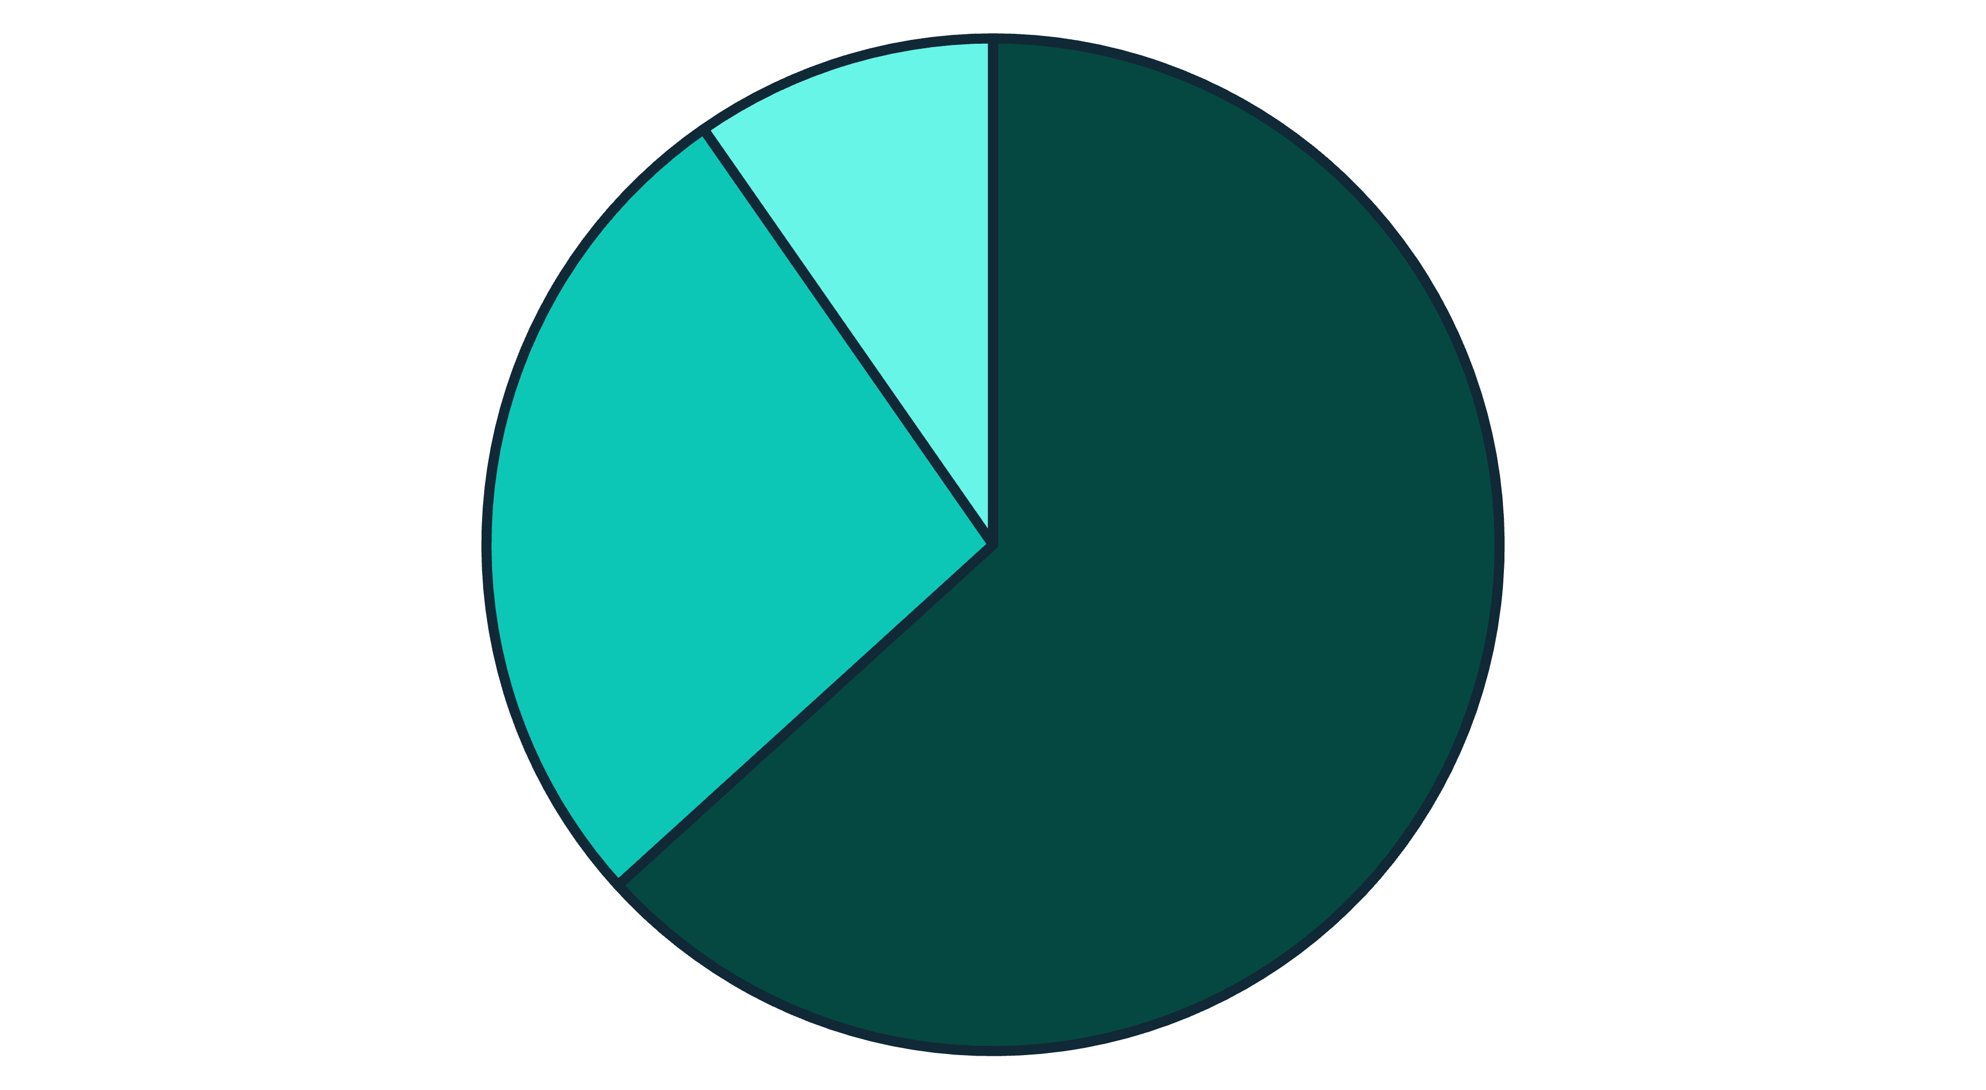
Visitor Motivation
Purpose of Visit Insights
Analyzing the purpose of visit provides crucial insights into traveler motivations, allowing for more precise marketing and service development. The dashboard categorizes visits into three primary purposes, revealing the dominant segments within the tourism sector. This data is graphically represented in the "Purpose Mix" pie chart on Page 1 of the project's visual documentation.
Leisure
Business
Medical
As the chart clearly illustrates, leisure tourism constitutes the overwhelming majority of visits, underscoring its significant role in the overall tourism economy. This dominance suggests that efforts to attract and cater to leisure travelers should remain a top priority. However, the substantial portions of business and medical tourism also highlight opportunities for specialized services and infrastructure development.

